Slide 2
Topics of presentation
SCADA
DCS

Slide 3
Prepared By
Jalil Ahmed
Syed Irfan Haider
Saeed Qadir
Ahsan Ali
Zaigham Abbas

Slide 4
Scada
Supervisory Control and Data Acquisition

Slide 5
Introduction
Acronym stands for Supervisory Control and Data Acquisition
Not a full control system, but rather focuses on the supervisory level
Purely software package that is positioned on top of hardware
Combination of telemetry and data acquisition to which it is interfaced, generally via (PLCs) or (DCS)
Collecting of the information, transferring it back to the central site, carrying out any necessary analysis and control and then displaying that information on a number of operator screens or displays control actions are then conveyed back to the process.

Slide 6
Introduction…….

Slide 7
Introduction…….

Slide 8
Introduction…..

Slide 9
Introduction…….
SCADA systems are designed to collect field information, transfer it to a central computer facility, and display the information to the operator graphically or textually, thereby allowing the operator to monitor or control an entire system a central location in real time.

Slide 10
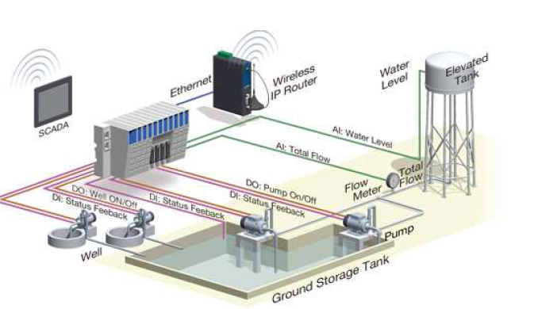
Intro…..
All together, the term SCADA refers to the entire central system. The central system usually monitors data from various sensors that are either in close proximity or off site.

Slide 11
Applications of scada
Electric power generation, transmission and distribution:
Water and sewage:
Buildings, facilities and environments:
Manufacturing:
Mass transit:
Traffic signals:

Slide 12
SCADA architecture
Three generations of SCADA systems:
First Generation Monolithic
Second Generation Distributed
Third Generation Networked

Slide 13
Monolithic SCADA Systems:

Slide 14
Distributed SCADA Systems:

Slide 15
Networked SCADA Systems:

Slide 16
Components of SCADA System
Hardware
SCADA system involves essentially five levels or hierarchies(System):
Field level instrumentation and control devices
Marshalling terminals and RTUs
Communications system
The master station(s)
The commercial data processing department computer system

Slide 17
Components of SCADA System
SCADA Software:
SCADA may be classified as:
Propriety:
Companies develop proprietary software to communicate to their hardware.
Open:
They have high interoperability to mix different manufacturers’ equipment on same system.

Slide 18
Key features of SCADA software
User interface
Graphics displays
Alarms
Trends
RTU (and PLC) interface
Scalability
Access to data

Slide 19
Key features of SCADA software……
Database
Networking
Fault tolerance and
Redundancy
Client/server
Distributed processing

Slide 20
SCADA Works
SCADA system performs four functions:
1. Data acquisition
2. Networked data communication
3. Data presentation
4. Control
These functions are performed by four kinds of SCADA Components:
1. Sensors and control relays
2. Remote telemetry units (RTUs)
3. SCADA master units
4. Communications network

Slide 21
Considerations and benefits of SCADA system
• Overall control requirements
• Sequence logic
• Analog loop control
• Ratio and number of analog to digital points
• Speed of control and data acquisition
• Master/operator control stations
• Reliability/availability
• Speed of communications/update time/system scan rates
• System redundancy
• Expansion capability

Slide 22
DCS
Distributed Control System

Slide 23
DCS Introduction
A type of automated control system that is distributed throughout a machine to provide instructions to different parts of the machine. Instead of having a centrally located device controlling all machines, each section of a machine has its own computer that controls the operation. For instance, there may be one machine with a section that controls dry elements of cake frosting and another section controlling the liquid elements, but each section is individually managed by a DCS. A DCS is commonly used in manufacturing equipment and utilizes input and output protocols to control the machine.

Slide 24
Distributed Control System (DCS)

Slide 25
DCS Elements
Local Control Unit
This unit can handle 8 to 16 individual PID loops.
Data Acquisition Unit
Digital (discrete) and analog I/O can be handle.
Batch Sequencing Unit
This unit controls a timing counters, arbitrary function generators, and internal logic.
Local Display
This device provides analog display stations, and video display for readout.
Bulk Memory Unit
This unit is used to store and recall process data.

Slide 26
DCS Elements
General Purpose Computer :
This unit is programmed by a customer or third party to perform optimization, advance control, expert system etc.
Central Operator Display
This unit typically contain several consoles for operator communication with the system, and multiple video color graphics display units
Data Highway
A serial digital data transmission link connecting all other components in the system. It allow for redundant data highway to reduce the risk of data loss
Local area Network (LAN)

Slide 27
Advantages of DCS
Access a large amount of current information from the data highway.
Monitoring trends of past process conditions.
Readily install new on-line measurements together with local computers.
Alternate quickly among standard control strategies and readjust controller parameters in software.
A sight full engineer can use the flexibility of the framework to implement his latest controller design ideas on the host computer.
Digital DCS systems are more flexible. Control algorithms can be changed and control configuration can be modified without having rewiring the system.

Slide 28
Advanced control topology

Slide 29
Functional levels of a typical Distributed Control System.

