Slide 1
Wireless Power Transmission

Slide 2
Overview
What is wireless power transmission(WPT)?
Why is WPT?
History of WPT
Types of WPT
  Techniques to transfer energy wirelessly
Advantages and disadvantages
Applications
Conclusion
References

Slide 3
What is WPT?
The transmission of energy from one place to another without using wires
Conventional energy transfer is using wires
But, the wireless transmission is made possible by using various technologies

Slide 4
Why not wires?
As per studies, most electrical energy transfer is through wires.
Most of the energy loss is during transmission
  On an average, more than 30%
  In India, it exceeds 40%

Slide 5
Why WPT?
Reliable
Efficient
Fast
Low maintenance cost
Can be used for short-range or long-range.

Slide 6
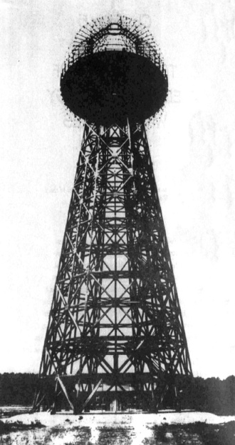
History
Nikola Tesla in late 1890s
Pioneer of induction techniques
His vision for “World Wireless System”
The 187 feet tall tower to broadcast energy
All people can have access to free energy
Due to shortage of funds, tower did not operate

Slide 7
History (contd…)
Tesla was able to transfer energy from one coil to another coil
He managed to light 200 lamps from a distance of 40km
The idea of Tesla is taken in to research after 100 years by a team led by Marin Soljačić from MIT. The project is named as ‘WiTricity’.

Slide 8
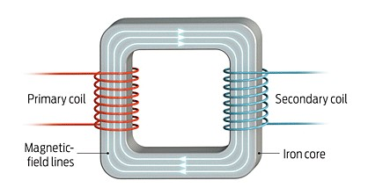
Energy Coupling
The transfer of energy
  Magnetic coupling
  Inductive coupling
Simplest Wireless Energy coupling is a transformer

Slide 9
Types and Technologies of WPT
Near-field techniques
  Inductive Coupling
  Resonant Inductive Coupling
  Air Ionization
Far-field techniques
  Microwave Power Transmission (MPT)
  LASER power transmission

Slide 10
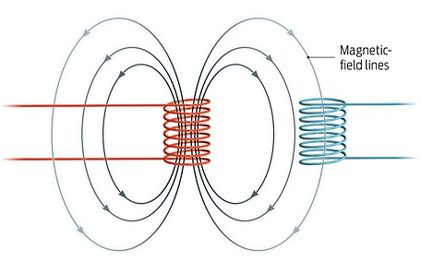
Inductive coupling
Primary and secondary coils are not connected with wires.
Energy transfer is due to Mutual Induction

Slide 11
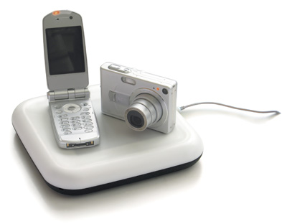
Inductive coupling (contd…)
Transformer is also an example
Energy transfer devices are usually air-cored
Wireless Charging Pad(WCP),electric brushes are some examples
On a WCP, the devices are to be kept, battery will be automatically charged.

Slide 12
Inductive coupling(contd…)
Electric brush also charges using inductive coupling
The charging pad (primary coil) and the device(secondary coil) have to be kept very near to each other
It is preferred because it is comfortable.
Less use of wires
Shock proof

Slide 13
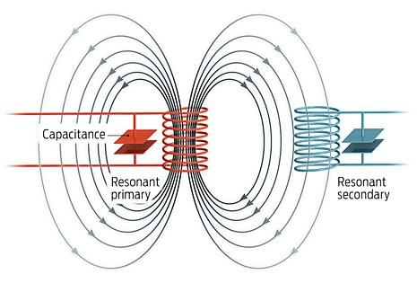
Resonance Inductive Coupling(RIC)
Combination of inductive coupling and resonance
Resonance makes two objects interact very strongly
Inductance induces current

Slide 14
How resonance in RIC?
Coil provides the inductance
Capacitor is connected parallel to the coil
Energy will be shifting back and forth between magnetic field surrounding the coil and electric field around the capacitor
Radiation loss will be negligible

Slide 15
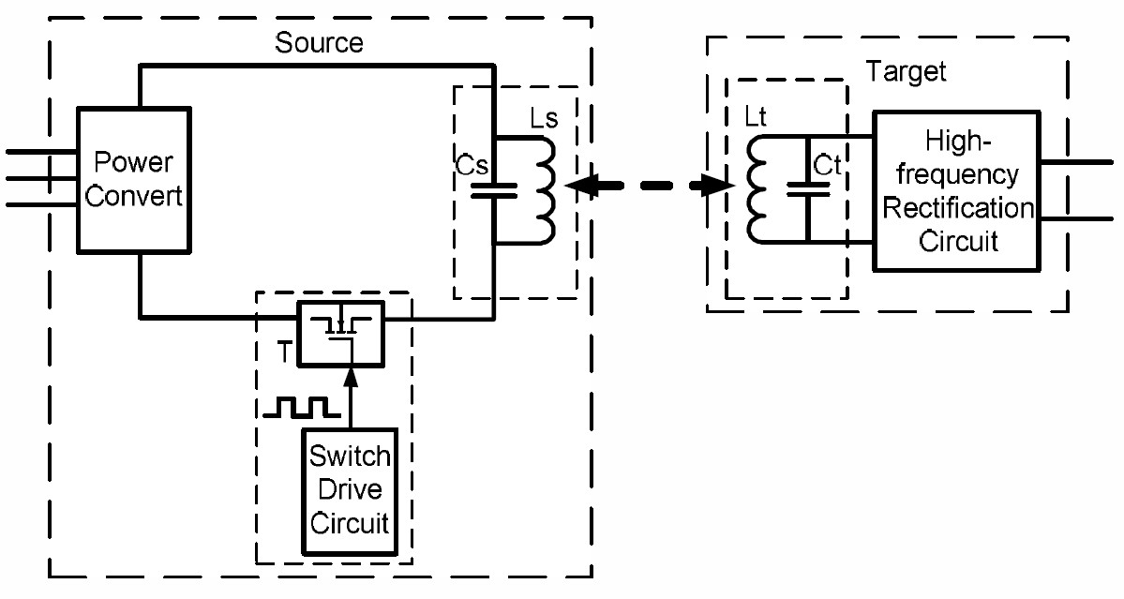
Block diagram of RIC

Slide 16
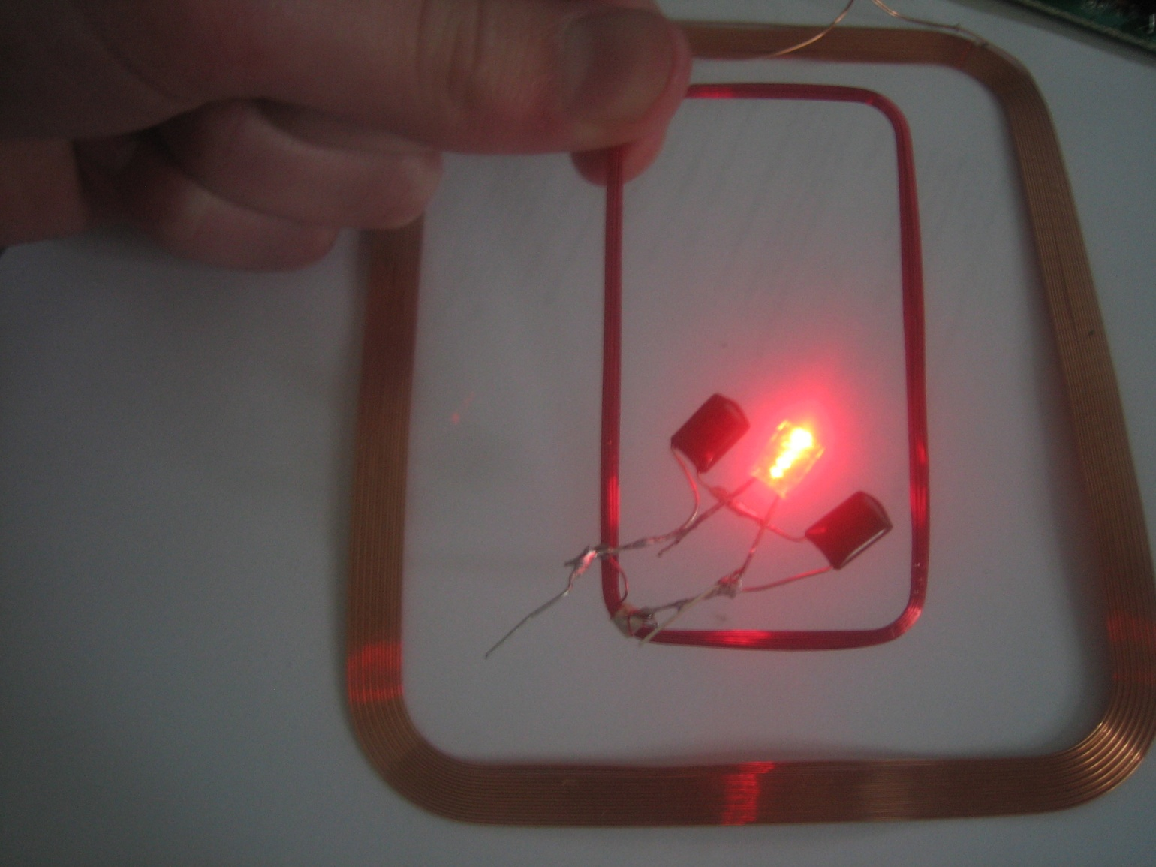
An example

Slide 17
WiTricity
Based on RIC
Led by MIT’s Marin Soljačić
Energy transfer wirelessly for a distance just more than 2m.
Coils were in helical shape
No capacitor was used
Efficiency achieved was around 40%

Slide 18
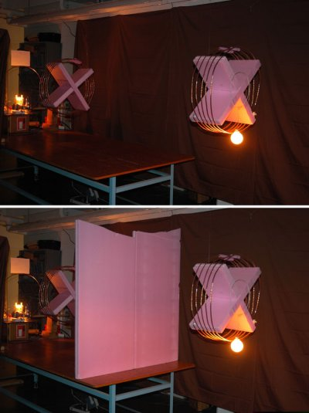
WiTricity (contd…)

Slide 19

WiTricity… Some statistics
Used frequencies are 1MHz and 10MHz
At 1Mhz, field strengths were safe for human
At 10MHz, Field strengths were more than ICNIRP standards

Slide 20
WiTricity now…
No more helical coils
Companies like Intel are also working on devices that make use of RIC
Researches for decreasing the field strength
Researches to increase the range

Slide 21
RIC vs. inductive coupling
RIC is highly efficient
RIC has much greater range than inductive coupling
RIC is directional when compared to inductive coupling
RIC can be one-to-many. But usually inductive coupling is one-to-one
Devices using RIC technique are highly portable

Slide 22
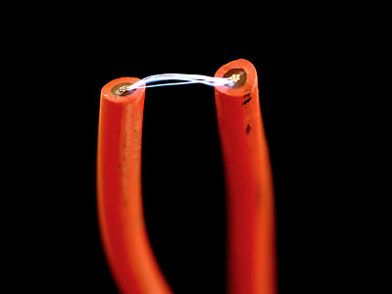
Air Ionization
Toughest technique under near-field energy transfer techniques
Air ionizes only when there is a high field
Needed field is 2.11MV/m
Natural example: Lightening
Not feasible for practical implementation

Slide 23
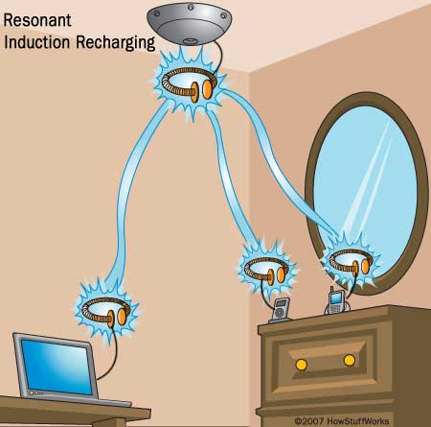
Advantages of near-field techniques
No wires
No e-waste
Need for battery is eliminated
Efficient energy transfer using RIC
Harmless, if field strengths under safety levels
Maintenance cost is less

Slide 24
Disadvantages
Distance constraint
Field strengths have to be under safety levels
Initial cost is high
In RIC, tuning is difficult
High frequency signals must be the supply
Air ionization technique is not feasible

Slide 25
Far-field energy transfer
Radiative
Needs line-of-sight
LASER or microwave
Aims at high power transfer
Tesla’s tower was built for this

Slide 26
Microwave Power Transfer(MPT)
Transfers high power from one place to another. Two places being in line of sight usually
Steps:
  Electrical energy to microwave energy
  Capturing microwaves using rectenna
  Microwave energy to electrical energy

Slide 27
MP T (contd…)
AC can not be directly converted to microwave energy
AC is converted to DC first
DC is converted to microwaves using magnetron
Transmitted waves are received at rectenna which rectifies, gives DC as the output
DC is converted back to AC

Slide 28
LASER transmission
LASER is highly directional, coherent
Not dispersed for very long
But, gets attenuated when it propagates through atmosphere
Simple receiver
  Photovoltaic cell
Cost-efficient

Slide 29
Solar Power Satellites (SPS)
To provide energy to earth’s increasing energy need
To efficiently make use of renewable energy i.e., solar energy
SPS are placed in geostationary orbits

Slide 30
SPS (contd…)
Solar energy is captured using photocells
Each SPS may have 400 million photocells
Transmitted to earth in the form of microwaves/LASER
Using rectenna/photovoltaic cell, the energy is converted to electrical energy
Efficiency exceeds 95% if microwave is used.

Slide 31
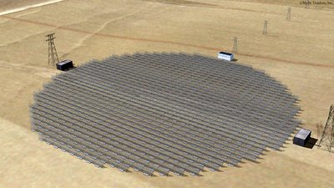
Rectenna
Stands for rectifying antenna
Consists of mesh of dipoles and diodes
Converts microwave to its DC equivalent
Usually multi-element phased array

Slide 32

Rectenna in US
Rectenna in US receives 5000MW of power from SPS
It is about one and a half mile long

Slide 33
Other projects
Alaska’21
Grand Bassin
Hawaii

Slide 34
LASER vs. MPT
When LASER is used, the antenna sizes can be much smaller
Microwaves can face interference (two frequencies can be used for WPT are 2.45GHz and 5.4GHz)
LASER has high attenuation loss and also it gets diffracted by atmospheric particles easily

Slide 35
Advantages of far-field energy transfer
Efficient
Easy
Need for grids, substations etc are eliminated
Low maintenance cost
More effective when the transmitting and receiving points are along a line-of-sight
Can reach the places which are remote

Slide 36
Disadvantages of far-field energy trasnfer
Radiative
Needs line-of-sight
Initial cost is high
When LASERs are used,
  conversion is inefficient
  Absorption loss is high
When microwaves are used,
  interference may arise
  FRIED BIRD effect

Slide 37
Applications
Near-field energy transfer
  Electric automobile charging
    Static and moving
  Consumer electronics
  Industrial purposes
    Harsh environment
Far-field energy transfer
  Solar Power Satellites
  Energy to remote areas
  Can broadcast energy globally (in future)

Slide 38
Conclusion
Transmission without wires- a reality
Efficient
Low maintenance cost. But, high initial cost
Better than conventional wired transfer
Energy crisis can be decreased
Low loss
In near future, world will be completely wireless

