Slide 2
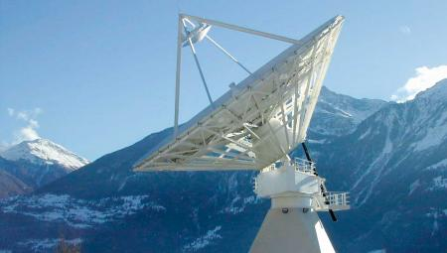
SATELLITE COMMUNICATION

Slide 3
GROUP MEMBERS
Jalil Ahmed
Sadia Imtiaz
Zaigham Abbas
Faisal Jamil

Slide 4
Topics of Presentation
Introduction
Launching
Applications
Satellites
How it works
Frequency
Bands

Slide 5
What are Communication Satellites?
A satellite is an object that orbits another large object like planet.
A communication satellite is a station in space that is used for telecommunication, radio and television signals.
The first satellite with radio transmitter was in 1957.

Slide 6
INTRODUCTION
Satellite is a microwave repeater in the space.
There are about 750 satellite in the space, most of them are used for communication.
They are:
Wide area coverage of the earth’s surface.
Transmission delay is about 0.3 sec.
Transmission cost is independent of distance.

Slide 7
HOW DO SATELLITES WORK
Two Stations on Earth want to communicate through radio broadcast but are too far away to use conventional means.
The two stations can use a satellite as a relay station for their communication
One Earth Station sends a transmission to the satellite. This is called a Uplink.
The satellite Transponder converts the signal and sends it down to the second earth station. This is called a Downlink.

Slide 8
ADVANTAGES OF SATELLITE
The advantages of satellite communication over terrestrial communication are:
The coverage area of a satellite greatly exceeds that of a terrestrial system.
Transmission cost of a satellite is independent of the distance from the center of the coverage area.
Satellite to Satellite communication is very precise.
Higher Bandwidths are available for use.

Slide 9
DISADVANTAGES OF SATELLITE
The disadvantages of satellite communication:
Launching satellites into orbit is costly.
Satellite bandwidth is gradually becoming used up.
There is a larger propagation delay in satellite communication than in terrestrial communication

Slide 10
HOW SATELLITES ARE USED
Service Types
Fixed Service Satellites (FSS)
Example: Point to Point Communication
Broadcast Service Satellites (BSS)
Example: Satellite Television/Radio
Also called Direct Broadcast Service (DBS).
Mobile Service Satellites (MSS)
Example: Satellite Phones

Slide 11
SATELLIE ORBITS
Satellite Orbits
GEO
LEO
MEO
MOLNIYA
HAP

Slide 12
Geostationary Earth Orbit (GEO)
These satellites are in orbit 35,863 km above the earth’s surface along the equator.
Objects in Geostationary orbit revolve around the earth at the same speed as the earth rotates. This means GEO satellites remain in the same position relative to the surface of earth.

Slide 13
GEO (cont.)
Advantages
A GEO satellite’s distance from earth gives it a large coverage area, almost a fourth of the earth’s surface.
GEO satellites have a 24 hour view of a particular area.
These factors make it ideal for satellite broadcast and other multipoint applications.

Slide 14
GEO (cont.)
Disadvantages
A GEO satellite’s distance also cause it to have both a comparatively weak signal and a time delay in the signal, which is bad for point to point communication.
GEO satellites, centered above the equator, have difficulty broadcasting signals to near polar regions

Slide 15
Low Earth Orbit (LEO)
LEO satellites are much closer to the earth than GEO satellites, ranging from 500 to 1,500 km above the surface.
LEO satellites don’t stay in fixed position relative to the surface, and are only visible for 15 to 20 minutes each pass.
A network of LEO satellites is necessary for LEO satellites to be useful

Slide 16
LEO (cont.)
Advantages
A LEO satellite’s proximity to earth compared to a GEO satellite gives it a better signal strength and less of a time delay, which makes it better for point to point communication.
A LEO satellite’s smaller area of coverage is less of a waste of bandwidth.

Slide 17
LEO (cont.)
Disadvantages
A network of LEO satellites is needed, which can be costly
LEO satellites have to compensate for Doppler shifts cause by their relative movement.
Atmospheric drag effects LEO satellites, causing gradual orbital deterioration.

Slide 18
Medium Earth Orbit (MEO)
A MEO satellite is in orbit somewhere between 8,000 km and 18,000 km above the earth’s surface.
MEO satellites are similar to LEO satellites in functionality.
MEO satellites are visible for much longer periods of time than LEO satellites, usually between 2 to 8 hours.
MEO satellites have a larger coverage area than LEO satellites.

Slide 19
MEO (cont.)
Advantage
A MEO satellite’s longer duration of visibility and wider footprint means fewer satellites are needed in a MEO network than a LEO network.
Disadvantage
A MEO satellite’s distance gives it a longer time delay and weaker signal than a LEO satellite, though not as bad as a GEO satellite.

Slide 20
Other Orbits
Molniya Orbit Satellites
Used by Russia for decades.
Molniya Orbit is an elliptical orbit. The satellite remains in a nearly fixed position relative to earth for eight hours.
A series of three Molniya satellites can act like a GEO satellite.
Useful in near polar regions.

Slide 21
Other Orbits (cont.)
High Altitude Platform (HAP)
One of the newest ideas in satellite communication.
A blimp or plane around 20 km above the earth’s surface is used as a satellite.
HAPs would have very small coverage area, but would have a comparatively strong signal.
Cheaper to put in position, but would require a lot of them in a network.

Slide 22
Frequency Bands
Different kinds of satellites use different frequency bands.
L–Band: 1 to 2 GHz, used by MSS
S-Band: 2 to 4 GHz, used by MSS, NASA, deep space research
C-Band: 4 to 8 GHz, used by FSS
X-Band: 8 to 12.5 GHz, used by FSS and in terrestrial imaging, ex: military and meteorological satellites
Ku-Band: 12.5 to 18 GHz: used by FSS and BSS (DBS)
K-Band: 18 to 26.5 GHz: used by FSS and BSS
Ka-Band: 26.5 to 40 GHz: used by FSS

Slide 23
FREQUENCY BAND (Cont.)
Three common bands:
C-Band.
KU-Band.
KA-Band.
Most common are C-Band & KU-Band.
C-Band occupy 4 to 8 GHz frequency: - Low frequency. - Large antenna (2-3 meters).
KU-Band occupy 11 to 17 GHz: - Large frequency. - Small antenna (18-inches!)

Slide 24
MULTIPLE ACCESS TECHNIQUES
FDMA (Frequency Division Multiple Access)
It is the oldest and most common.
the available satellite channel bandwidth is broken into frequency bands for different earth stations.
TDMA (Time Division Multiple Access)
channels are time multiplexed sequentially
Each earth station gets to transmit in a fixed time slot only.
More than one time slot can be assigned to stations with more bandwidth requirements.
Requires time synchronization between the Earth Stations.

Slide 25
CDMA : (Code Division Multiple Access)
Combination of time/frequency multiplexing
( a form of spread spectrum modulation).
It provides a decentralized way of providing separate channels without timing synchronization. It is a relatively new scheme but is expected to be more
common in future satellites.

Slide 26
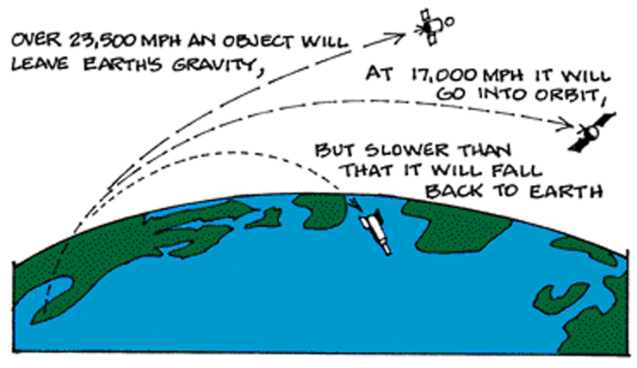
Launching Satellites
How does a satellite stay in it’s orbit?

Slide 27
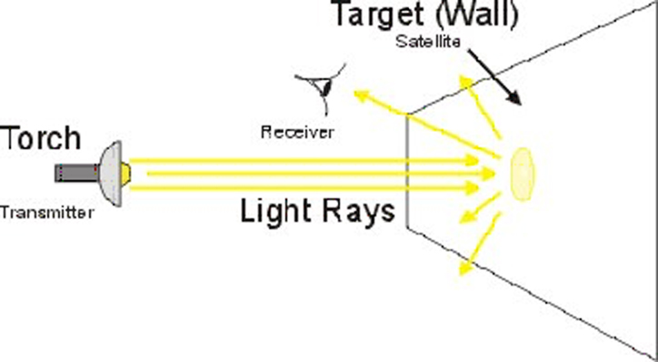
Consider the light bulb example:

Slide 28
Applications
Telephony - Fixed points< earth station> Satellite> earth station> fixed points.
Television & Radio - e.g. Direct broadcast satellite (DBS) & Fixed service satellite (FFS).
Mobile satellite technology - Special antenna called mobile satellite antenna. - No matter where or how this antenna is mounted on.

Slide 29
Applications
Amateur radio - Access to OSCAR satellite. - Low earth orbits.
Internet - High Speed. - Useful for far away places.
Military - Uses geostationary satellites. - Example: The Defense Satellite Communications System (DSCS).

Slide 30
In Conclusion
Satellites remain the best utilization used for communications due to their speed and other advantages mentioned in this presentation.

