Slide 2
GROUP NO 5
Members
GULREZ MANZOOR 10EE58
IRFAN HAIDER 10EE55
KAMRAN ZAFER 10EE50
SAEED QADIR 10EE62

Slide 3
IRFAN

Slide 4
SONAR

Slide 5
WHAT IS SONAR
So - Sonographic
Na - Navigation
R - Ranging
It is a method for detecting and finding the distance of objects underwater by means of reflected ultrasonic ways. The device used in this method is also called sonar

Slide 6
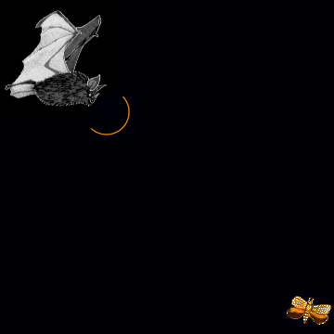
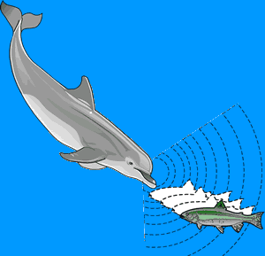
HISTORY OF SONAR
Actually animals use echolocation and that is actually where we learned the technique
Bats, whales, and dolphins are some of the best known animals to use echolocation

Slide 7
Introduction to Ultrasonics
The word ultrasonic combines the Latin roots ultra, meaning ‘beyond’ and sonic, or sound.
The sound waves having frequencies above the audible range i.e. above 20000Hz are called ultrasonic waves.
Generally these waves are called as high frequency waves.
The field of ultrasonics have applications for imaging, detection and navigation.
The broad sectors of society that regularly apply ultrasonic technology are the medical community, industry, the military and private citizens.
Notes:
7

Slide 8
Properties of ultrasonic waves
(1) They have a high energy content.
(2) Just like ordinary sound waves, ultrasonic waves
get reflected, refracted and absorbed.
(3) They can be transmitted over large distances
with no appreciable loss of energy.
(4) If an arrangement is made to form stationary waves of ultrasonics in a liquid, it serves as a diffraction grating. It is called an acoustic grating.
(5) They produce intense heating effect when passed through a substance.
Notes:
8

Slide 9
Ultrasonics Production
Ultrasonic waves are produced by the
following methods.
(1) Magneto-striction generator or oscillator
(2) Piezo-electric generator or oscillator
Notes:
9

Slide 10
GULREZ

Slide 11
Magnetoagnetostriction Generator
Principle: Magnetostriction effect
When a ferromagnetic rod like iron or nickel is placed in a magnetic field parallel to its length, the rod experiences a small change in its length.This is called magnetostricion effect.
Notes:
11

Slide 12
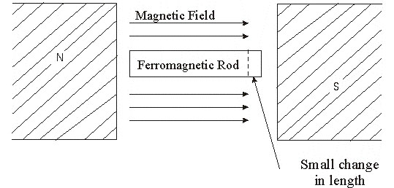
The change in length (increase or decrease) produced in the rod depends upon the strength of the magnetic field, the nature of the materials and is independent of the direction of the magnetic field applied.
Notes:
12

Slide 13
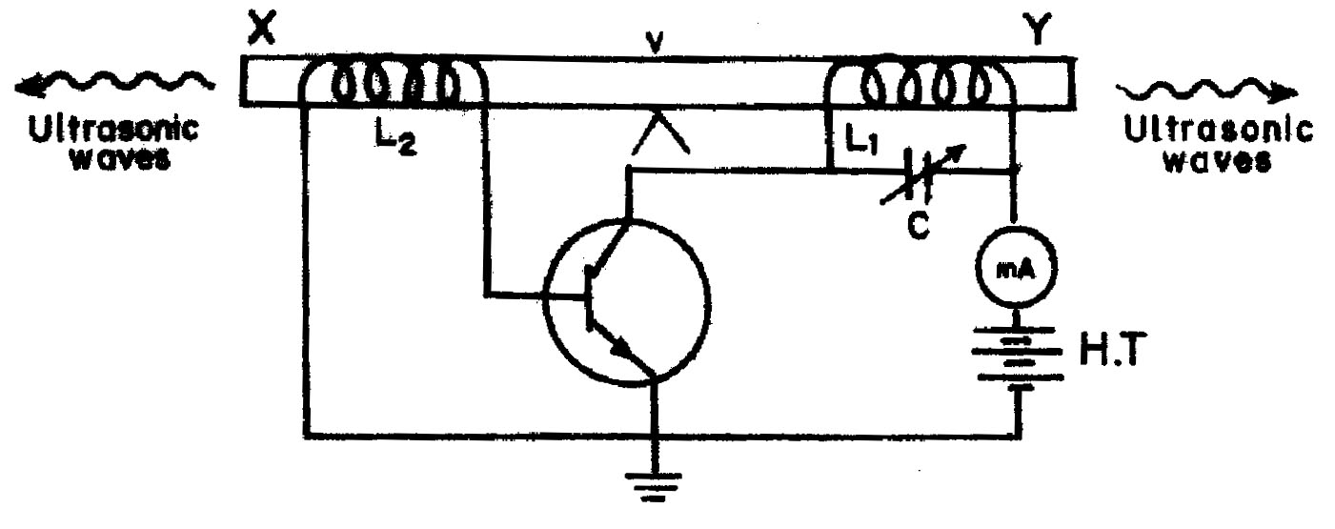
Construction
Notes:
13

Slide 14
XY is a rod of ferromagnetic materials like iron or nickel. The rod is clamped in the middle.
The alternating magnetic field is generated by electronic oscillator.
The coil L₁ wound on the right hand portion of the rod along with a variable capacitor C.
This forms the resonant circuit of the collector tuned oscillator. The frequency of oscillator is controlled by the variable capacitor.
The coil L₂ wound on the left hand portion of the rod is connected to the base circuit. The coil L₂ acts as feed –back loop.
Notes:
14

Slide 15
Working
When High Tension (H.T) battery is switched on, the collector circuit oscillates with a frequency,
f =
This alternating current flowing through the coil L₁ produces an alternating magnetic field along the length of the rod. The result is that the rod starts vibrating due to magnetostrictive effect.
Notes:
15

Slide 16
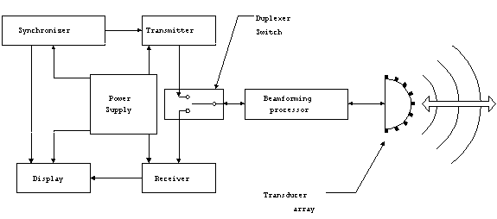
BLOCK DIAGHRAM OF SONAR

Slide 17
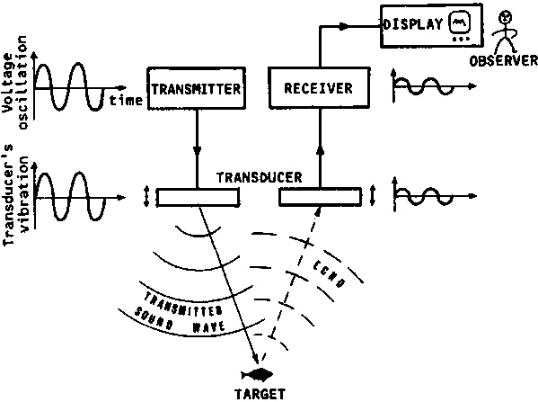

Slide 18
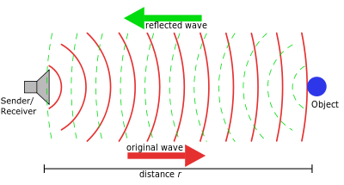

Slide 19
KAMRAN

Slide 20
What does the Sonar consists ?
(1) a hydrophone
(2) an electronic receiver
(3) a bearing indicator
(4) a speaker or headphone

Slide 21
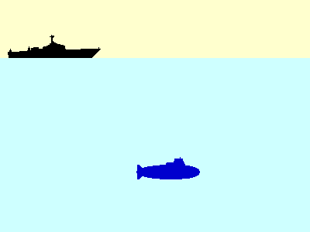
Working of sonar
Sound travels 1460 meters per second (approx. 1500 mps), in water, not in a vacuum

Slide 22
Navigation and Ranging Issues
Depth is determined by dividing travel time of sound by 2 and then multiplying by 1500 mps
If 12 seconds was the travel time, then
12/2 = 6X1500 = 9000 meters deep
Frequency of sound appears to increase when an observer moves toward a source and appears to decrease when he moves away from it. Similarly, if the source is moving toward the observer, the frequency is higher; if the source is moving away from the observer, it is lower.

Slide 23
What do we use sonar for
First developed in WWII to detect submarines
Used to detect icebergs
Calculating Water depth
Locate sunken ships/or other historical objects
Military uses it still to detect subs and aim weapons
Locate fish or track animals that are being studied
Mapping underwater features

Slide 24
SAEED

Slide 25
How a map is made with a imaging sonar ?
A Sonar echo recorder is dragged behind a ship and is called a towfish
It sends out a ping … sound travels to the bottom and is reflected back to the hydrophone
An instrument on the ship collects and analyzes the data
These points of data are combined to create a picture of the seafloor

Slide 26
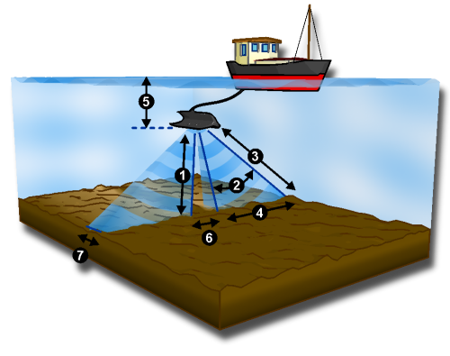
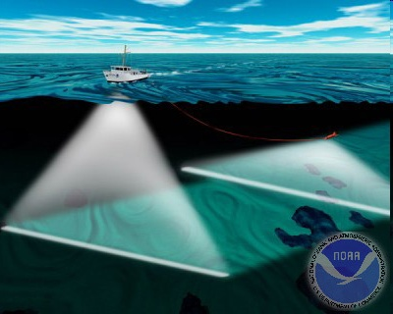
Side-Scan Sonar Systems
Types of Imaging Sonar
The sound frequencies used in side-scan sonar usually range from 100 to 500 kHz
Designed to look sideways and at a downward angle from both sides of a towed unit, called a towfish. The bottom and any objects in the water above the bottom reflect sound waves back to the towed array. An image is produced from this information .

Slide 27
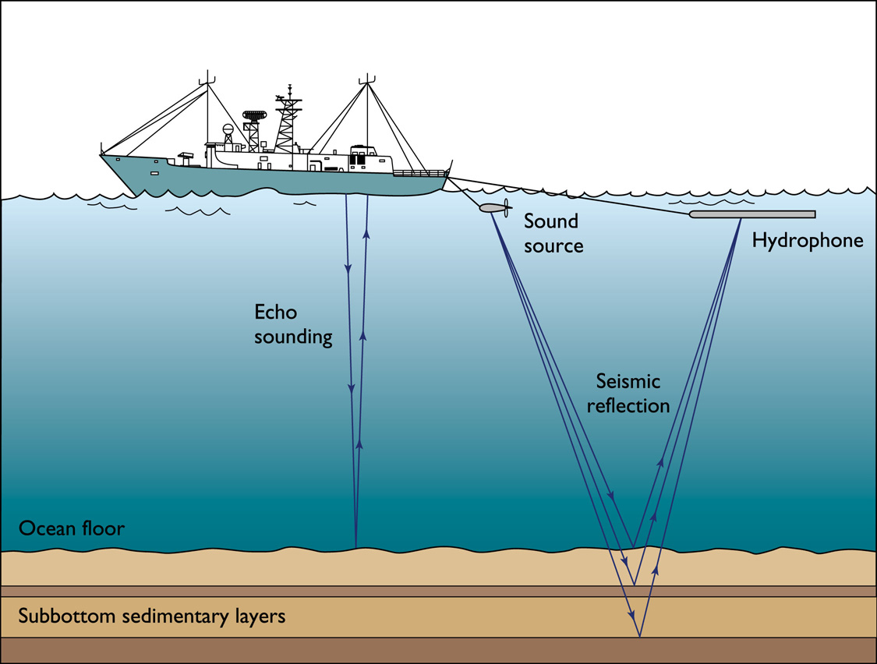

Slide 28
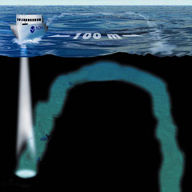
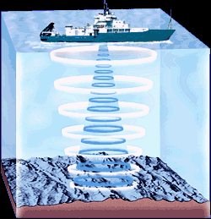
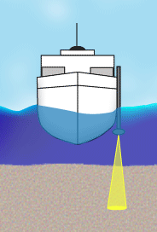
Single-beam Sonar Systems
The ship sends out a single beam of sonar to the sea floor, kind of like a flashlight beam.
Used primarily for mapping channels and bathymetry for hydrologic and engineering applications.

Slide 30
THANK YOU……

