Slide 1
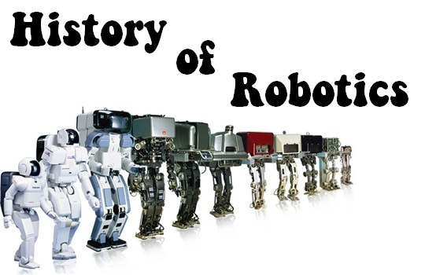
Robotics and Automation
Evolution of Robotics and Robot Classifications

Slide 2
introduction
The purpose of this lesson is to identify areas in robotics where quality, reliability, and safety can be designed into a product. We will learn specifically about the Evolution of Robotics and Robot Classifications.

Slide 3
Technical communication
Students enrolled in this course will demonstrate knowledge and skills necessary for the robotic and automation industry. Through implementation of the design process, students will transfer advanced academic skills to component designs in a project-based environment. Students will build prototypes or use simulation software to test their designs. Additionally, students explore career opportunities, employer expectations, and educational needs in the robotic and automation industry.
Copyright © Texas Education Agency, 2012. All rights reserved.

Slide 4
LESSON SECTIONS
TEKS 130.370(c)(10)(B) Identify areas in robotics where quality, reliability, and safety can be designed into a product.
- Section 1: Evolution of Robotics
- Section 2: Robot Classifications
Copyright © Texas Education Agency, 2012. All rights reserved.

Slide 5
SECTION I - Objectives
130.370(c)(10)(B) Identify areas in robotics where quality, reliability, and safety can be designed into a product.
- Section 1: Evolution of Robotics
Copyright © Texas Education Agency, 2012. All rights reserved.

Slide 6
SECTION I – Evolution of Robotics VIDEO
Watch a video on the History of Robot Evolution in 2007.
Copyright © Texas Education Agency, 2012. All rights reserved.

Slide 7
Technical Terms & Definitions (1 of 4)
The terms and definitions listed below are discussed in this lesson. Please review before proceeding with this lesson.
Copyright © Texas Education Agency, 2012. All rights reserved.
Terms | Definitions
Artificial Intelligence | is a branch of computer science dealing with the simulation of intelligent behavior in computers.

Slide 8
Technical Terms & Definitions (2 of 4)
The terms and definitions listed below are discussed in this lesson. Please review before proceeding with this lesson.
Copyright © Texas Education Agency, 2012. All rights reserved.
Terms | Definitions
Evolution | is as a process of continuous change from a lower, simpler, or worse to a higher, more complex, or better state.

Slide 9
Technical Terms & Definitions (3 of 4)
The terms and definitions listed below are discussed in this lesson. Please review before proceeding with this lesson.
Copyright © Texas Education Agency, 2012. All rights reserved.
Terms | Definitions
History | is a branch of knowledge that records and explains past events <robotics history>.

Slide 10
Technical Terms & Definitions (4 of 4)
The terms and definitions listed below are discussed in this lesson. Please review before proceeding with this lesson.
Copyright © Texas Education Agency, 2012. All rights reserved.
Terms | Definitions
Robotics | is technology dealing with the design, construction, and operation of robots.

Slide 11
SECTION I – Evolution of Robotics
It is important to study the Evolution of Robotics.
The Evolution of Robotics enables students to:
Observe the rate and order of the robot’s development.
Reveals the historical steps by which the robot developed.
Shows how far ahead of technology people’s dreams move and points out which dreams remain unfulfilled.
Copyright © Texas Education Agency, 2012. All rights reserved.

Slide 12
SECTION I – Evolution of Robotics
Key events in the Evolution of Robotics dates back to ancient times.
The successful building of robots goes back hundreds of years ago.
Some of the major developments in robots are listed by timeline, the name of robot developer, and the description of the robot.
Copyright © Texas Education Agency, 2012. All rights reserved.

Slide 13
SECTION I – Evolution of Robotics (1 of 10)
Timeline | Robot Developer | Robot Description
1000 B.C. | Romans | Abacus (bead-adding machine)
100 B.C . | Greeks | Greek ship with analog navigational computer on board
1624 | Blaise Pascal | Calculator for adding and subtracting (mass produced)
1730-1780 | Japanese | Clockwork automations
1812 | Charles Babbage | Theory of automated computing Difference Engine
Copyright © Texas Education Agency, 2012. All rights reserved.

Slide 14
Evolution of Robotics – The ABACUS
Abacus - First Known Use: 14th century
Ancient Times: The Salamis Tablet, the Roman Calculi and Hand-abacus are from the period c. 300 B.C to c. 500 A.D.
An instrument for making calculations by sliding counters along rods or in grooves.
Copyright © Texas Education Agency, 2012. All rights reserved.

Slide 15
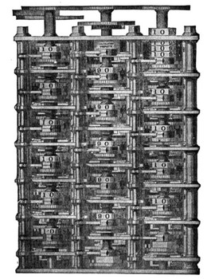
Evolution of Robotics – charles babbage – difference engine
Difference Engine - In 1821 Babbage invented an Engine to manufacture
error-free mathematical tables, Difference Engine No.1, the world's first
programmable automatic digital calculating machine, in which the only
human intervention was the setting of the machine at the start of the
production of a table and the turning of its handle.
Copyright © Texas Education Agency, 2012. All rights reserved.

Slide 16
SECTION I – Evolution of Robotics (2 of 10)
Timeline | Robot Developer | Robot Description
1833 | Charles Babbage | Analytical engine
1880s | Railroads | Automaton railroad signal that looks like a man and operates on electricity
1890 | Herman Hollerith | Punch card tabulating equipment for U.S. census
1900 | James Power | 1900 census with simultaneous punching
1921 | Karel Capek | First use of the word robot, in the play Rossum’s Universal Robots
Copyright © Texas Education Agency, 2012. All rights reserved.

Slide 17
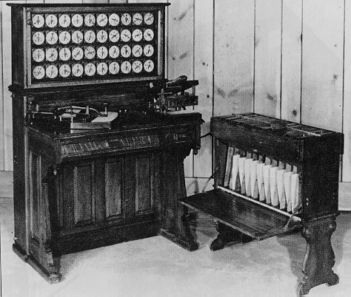
Evolution of Robotics - Herman Hollerith - Punch Cards
Herman Hollerith invented and used a punched card device to help analyze
the 1890 US census data. Herman Hollerith's great breakthrough was his use
of electricity to read, count, and sort punched cards whose holes represented
data gathered by the census-takers. His machines were used for the 1890
census and accomplished in one year what would have taken nearly ten years
of hand tabulating.
Copyright © Texas Education Agency, 2012. All rights reserved.

Slide 18
SECTION I – Evolution of Robotics (3 of 10)
Timeline | Robot Developer | Robot Description
1939 | John V. Atanasoff | ABC model computer (Atanasoff-Berry computer), first electronic computer
1939-1944 | Howard H. Aiken | Harvard/IBM Mark I electromechanical calculator
1940 | Issac Asimov | First use of the word robotics
1945 | Mauchly and Eckert | ENIAC, first useful electronic computer
Copyright © Texas Education Agency, 2012. All rights reserved.

Slide 19
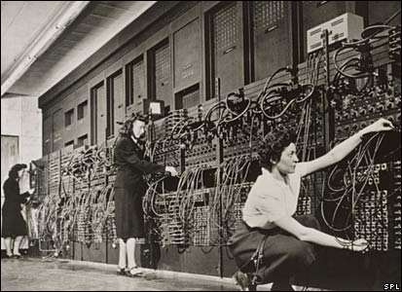
Evolution of Robotics –ENIAC electronic computer
In 1945, John Mauchly and John Presper Eckert developed the ENIAC I
(Electrical Numerical Integrator And Calculator). The American military
sponsored their research; the army needed a computer for calculating
artillery-firing tables, the settings used for different weapons under varied
conditions for target accuracy.
Copyright © Texas Education Agency, 2012. All rights reserved.

Slide 20
SECTION I – Evolution of Robotics (4 of 10)
Timeline | Robot Developer | Robot Description
1956 | George Devol | First programmable robot designed for what will become Unimation. U.S. patent issued in 1961.
1959 | Planet Corp. | Marketing of first commercially available robot
1961 | Unimation | First Unimate robot installed to tend a die casting machine
Copyright © Texas Education Agency, 2012. All rights reserved.

Slide 21
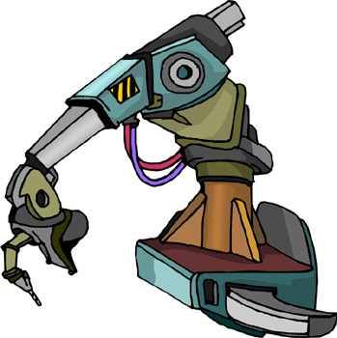
Evolution of Robotics – unimate robot
The first Unimate was installed at a plant to work with heated die-casting machines. In fact most Unimates were sold to extract die castings from die casting machines and to perform spot welding on auto bodies, both tasks being particularly hateful jobs for people.
Copyright © Texas Education Agency, 2012. All rights reserved.

Slide 22
SECTION I – Evolution of Robotics (5 of 10)
Timeline | Robot Developer | Robot Description
1964 | MIT, Stanford, and University of Edinburgh | Artificial Intelligence Research Laboratories opened at MIT, Stanford, and University of Edinburgh
1968 | Unimation | Unimation takes its first multi-robot order
1973 | Cincinnati Milacron | First commercially available minicomputer-controlled industrial robot
Copyright © Texas Education Agency, 2012. All rights reserved.

Slide 23
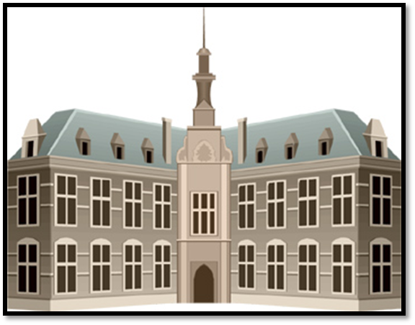
Evolution of Robotics – Artificial intelligence research laboratories
In 1964, the Artificial Intelligence Research Laboratories open at MIT,
Stanford, and University of Edinburgh.
Copyright © Texas Education Agency, 2012. All rights reserved.

Slide 24
SECTION I – Evolution of Robotics (6 of 10)
Timeline | Robot Developer | Robot Description
1976 | NASA | The robotic spacecraft Viking lands on the Martian surface
1979 | Carnegie Mellon University | The Robotics Institute at Carnegie Mellon University is established.
1984 | Joseph F. Engleberger | The “Father of Robotics” starts new computer called Transition Research Corp, concentrating on service robots
1987 | James L. Fuller | Hooter designed and built, becomes first college rally squad robot mascot
Copyright © Texas Education Agency, 2012. All rights reserved.

Slide 25
Evolution of Robotics – Carnegie mellon university
The Robotics Institute at Carnegie Mellon University is established in
1979.
Copyright © Texas Education Agency, 2012. All rights reserved.

Slide 26
SECTION I – Evolution of Robotics (7 of 10)
Timeline | Robot Developer | Robot Description
1989 | FIRST | FIRST was founded in 1989 to inspire young people's interest and participation in science and technology.
1993 | BEST (Boosting Engineering, Science, and Technology) | BEST was founded in 1993 for the purpose of Boosting Engineering, Science, and Technology; and is a Robotic Competition.
Copyright © Texas Education Agency, 2012. All rights reserved.

Slide 27
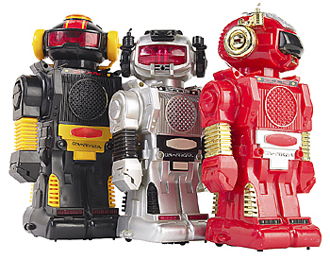
Evolution of Robotics - FIRST
FIRST was founded in 1989 to inspire young people's interest and
participation in science and technology.
Copyright © Texas Education Agency, 2012. All rights reserved.

Slide 28
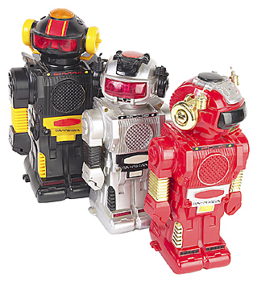
Evolution of Robotics - BEST
BEST was founded in 1993 for the purpose of Boosting Engineering, Science, and Technology.
Copyright © Texas Education Agency, 2012. All rights reserved.

Slide 29
SECTION I – Evolution of Robotics (8 of 10)
Timeline | Robot Developer | Robot Description
1997 | NASA | Pathfinder spacecraft lands on Mars with Sojourner rover robot to explore Mars.
2003 | NASA | June 10th – NASA launches the MER-A “Spirit” rover destined for Mars. July 7th - NASA launches the MER-B “Opportunity.”
2004 | NASA | January 23rd - The second Mars Exploration Rover – “Opportunity” safely lands on the Meridium Panum.
Copyright © Texas Education Agency, 2012. All rights reserved.

Slide 30
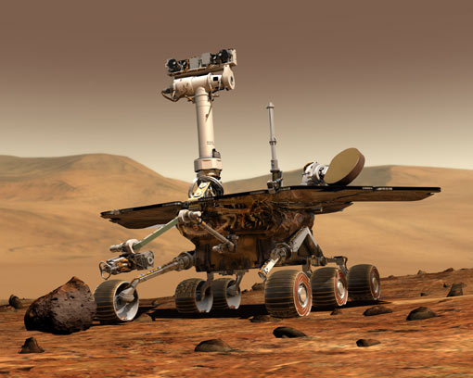
Evolution of Robotics - NASA
January 23, 2004 - The second Mars Exploration Rover – “Opportunity”
safely lands on the Meridium Panum.
Copyright © Texas Education Agency, 2012. All rights reserved.

Slide 31
SECTION I – Evolution of Robotics (9 of 10)
Timeline | Robot Developer | Robot Description
2007 | Carnegie Mellon University Robotics Institute | Boss won the DARPA Urban Challenge in 2007. DARPA – Defense Advanced Research Projects Agency
2010 | Carnegie Mellon University Robotics Institute & Astrobotic Technology | Red Rover is a lunar rover being developed by Carnegie Mellon and spin-off Astrobotic Technology for the Google Lunar X-Prize.
Copyright © Texas Education Agency, 2012. All rights reserved.

Slide 32
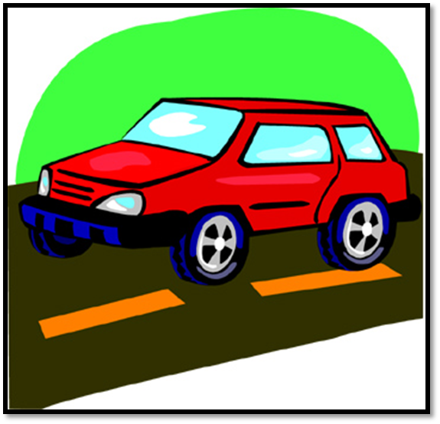
Evolution of Robotics - BOSS
Boss won the DARPA Urban Challenge in 2007.
DARPA – Defense Advanced Research Projects Agency
The challenge — meant to spur robotic development — will pit
autonomous vehicles against one another to see which can best
navigate roads in an urban military training facility without human help.
Copyright © Texas Education Agency, 2012. All rights reserved.

Slide 33
SECTION I – Evolution of Robotics (10 of 10)
Timeline | Robot Developer | Robot Description
2011 | Carnegie Mellon University Robotics Institute | Airboats are low cost flat-bottomed boats that use an above-water fan to propel themselves forward safely and effectively through shallow or debris-filled water.
Copyright © Texas Education Agency, 2012. All rights reserved.

Slide 34
SECTION I – Evolution of Robotics
Sources for Additional Information
ROVer Ranch
http://prime.jsc.nasa.gov/ROV/history.html
Carnegie Mellon University Robotics Institute
http://www.frc.ri.cmu.edu/robots/index.php
Robotics Research Group
http://www.robotics.utexas.edu/rrg/learn_more/history/
Robots: Re-Evolving Mind
http://www.frc.ri.cmu.edu/~hpm/project.archive/robot.papers/2000/robot.evolution.html
Copyright © Texas Education Agency, 2012. All rights reserved.

Slide 35
section 2 - Objectives
130.370(c)(10)(B) Identify areas in robotics where quality, reliability, and safety can be designed into a product.
- Section 2: Classification of Robots
Copyright © Texas Education Agency, 2012. All rights reserved.

Slide 36
Technical Terms & Definitions
The terms and definitions listed below are discussed in this lesson. Please review before proceeding with this lesson.
Copyright © Texas Education Agency, 2012. All rights reserved.
Terms | Definitions
Classification | is a systematic arrangement in groups or categories according to established criteria.

Slide 37
Manipulator
A manipulator is a device which is used to manipulate the materials without direct contact.
It is an arm like mechanism that consists of series of segments, usually sliding or jointed which grasp and move objects with a number of degree of freedom.

Slide 38
Manipulator (Contd….)
It has rigid links.
Connected with joints.
Instrumented with position sensor which allow the relative position of the neighboring links.
Joint angles in case of revolute joints.
Translation in case of prismatic joint.

Slide 39
Revolute Joints:
A revolute joint is also called pin joint.
It provides single axis rotation function. This one parameter movement identifies this joint as a one degree of freedom kinematic pair.
Prismatic Joints:
It provides a linear sliding movement between two bodies, often called a slider.
The relative position of two bodies connected by a prismatic joint is defined by the amount of linear slide of one relative to the other one. This one parameter movement identifies this joint as a one degree of freedom kinematic pair.

Slide 40
SECTION 2 – Classification of robots
Why Do We Need Robots?
Robots are:
Strong
Tireless
Accurate and Repeated
Well-immune
Robots provide labor savings. They are used to improve working conditions, increase flexibility, productivity and quality.
Copyright © Texas Education Agency, 2012. All rights reserved.

Slide 41
SECTION 2 – Classification of robots
What is the Classification of Robots?
The Classification of Robots section will explain several methods of robot classifications.
Copyright © Texas Education Agency, 2012. All rights reserved.

Slide 42
SECTION 2 – Classification of robots
Robot Classification Methods
1. Arm Configuration | 5. Tasks Performed
2. Controller | 6. Design
3. Power Supply | 7. LERT
4. Technology
Copyright © Texas Education Agency, 2012. All rights reserved.

Slide 43
SECTION 2 – Classification of robots
1. Classification by Arm Configuration
There are five recognized arm configurations:
Rectangular or Cartesian Coordinates
Cylindrical Coordinates
SCARA
Polar or Spherical Coordinates
Jointed Arm
Copyright © Texas Education Agency, 2012. All rights reserved.

Slide 44
Classification of robots – Types of Robots
Copyright © Texas Education Agency, 2012. All rights reserved.

Slide 45
Classification of robots – Arm Configuration (1 of 5)
Rectangular or Cartesian Coordinates
These robots move along an x, y, z axis in straight lines.
Copyright © Texas Education Agency, 2012. All rights reserved.

Slide 46
Classification of robots – Arm Configuration (2 of 5)
Cylindrical Coordinates
This robot manipulator can rotate about its base and can move linearly in horizontal and vertical planes.
Copyright © Texas Education Agency, 2012. All rights reserved.

Slide 47
Classification of robots – Arm Configuration (3 of 5)
SCARA
Selective Compliance Articulated Robot Arm (SCARA) – The work all is similar to a cylindrical robot, but is has a rotational reach axis rather than a linear one.
Copyright © Texas Education Agency, 2012. All rights reserved.

Slide 48
Classification of robots – Arm Configuration (4 of 5)
Polar or Spherical Coordinates
The manipulator can rotate about its head as well as its base. It can also move in and out.
Copyright © Texas Education Agency, 2012. All rights reserved.

Slide 49
Classification of robots – Arm Configuration (5 of 5)
Jointed Arm
These robot arms resemble the design of the human arm and have the largest work cell per amount of required floor space.
Copyright © Texas Education Agency, 2012. All rights reserved.

Slide 50
SECTION 2 – Classification of robots
2. Classification by Controller
There are three basic types of robot controllers:
Limited Sequence
Point-to-Point
Continuous Path
Copyright © Texas Education Agency, 2012. All rights reserved.

Slide 51
Classification of robots – Controller (1 of 3)
The Limited Sequence Controller uses a timer to determine when to activate an axis.
It uses mechanical stops or micro-switches to mark the end of the travel for an axis.
Copyright © Texas Education Agency, 2012. All rights reserved.

Slide 52
Classification of robots – Controller (2 of 3)
The Point-to-Point Controller has memory to hold the coordinates of each axis at various points in a task.
It uses sensors to help reach each point.
Copyright © Texas Education Agency, 2012. All rights reserved.

Slide 53
Classification of robots – Controller (3 of 3)
The Continuous Path Controller has larger memories than point-to-point controllers.
They are able to record many point coordinates per second.
Copyright © Texas Education Agency, 2012. All rights reserved.

Slide 54
SECTION 2 – Classification of robots
3. Classification by Power Supply
There are three basic types of robot power supplies:
Electrical
Pneumatic
Hydraulic
Copyright © Texas Education Agency, 2012. All rights reserved.

Slide 55
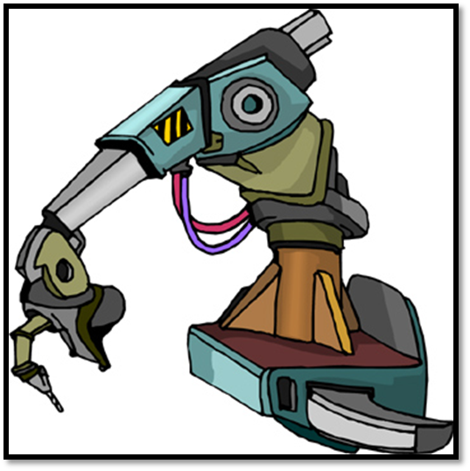
Classification of robots – Electrical Power supply (1 of 3)
Electrical Power Supply - if a robot is
powered by electricity, it is considered to be
an electric robot.
Copyright © Texas Education Agency, 2012. All rights reserved.

Slide 56
Classification of robots – Pneumatic Power supply (2 of 3)
A Pneumatic Robot requires another source of
energy such as electricity, propane or gasoline to
provide the compressed air.
Pneumatic - of, relating to, or
using gas (as air or wind):
a : moved or worked by air
pressure
Copyright © Texas Education Agency, 2012. All rights reserved.

Slide 57
Classification of robots – Hydraulic Power supply (3 of 3)
Hydraulic Power Supply - if a robot is powered by hydraulics, it is considered to be an hydraulic robot.
Hydraulic - operated, moved, or effected by
means of water.
Copyright © Texas Education Agency, 2012. All rights reserved.

Slide 58
SECTION 2 – Classification of robots
4. Classification by Technology
There are three levels of technology used for robots:
Low-Technology Level
Medium-Technology Level
High-Technology Level
Copyright © Texas Education Agency, 2012. All rights reserved.

Slide 59
Classification of robots – TECHNOLOGY (1 of 3)
The Low-Technology Level robots are used for material handling, loading and unloading, simple assembly operations, have 4-6 axes of movement, have a payload capacity of 25 pounds.
Copyright © Texas Education Agency, 2012. All rights reserved.

Slide 60
Classification of robots – TECHNOLOGY (2 of 3)
The Medium-Technology Level robots are used for picking up and placing, loading and unloading, have 4-6 axes of movement, payloads of 300 pounds.
Copyright © Texas Education Agency, 2012. All rights reserved.

Slide 61
Classification of robots – TECHNOLOGY (3 of 3)
The High-Technology Level robots are used for many manufacturing tasks, have 6-9 axes of movement, and 300 pound payloads.
Copyright © Texas Education Agency, 2012. All rights reserved.

Slide 62
SECTION 2 – Classification of robots
5. Classification by Tasks Performed
Classifying robots by the task they are designed to do is similar to classifying human workers by their occupations.
Some industrial robots work as painters, welders, assemblers, and materials transferors.
Others work as brain surgeons and artists.
Copyright © Texas Education Agency, 2012. All rights reserved.

Slide 63
SECTION 2 – Classification of robots (1 of 10)
6. Classification by Design
Classifying robots by their technological generation is similar to how electronic computers have been classified.
For example,
1st Generation of electronic computers used vacuum tubes.
2nd Generation of electronic computers used transistors, and so forth.
3rd Generation of electronic computers classification is open-ended. It leaves room for future expansion.
Copyright © Texas Education Agency, 2012. All rights reserved.

Slide 64
SECTION 2 – Classification of robots (2 of 10)
6. Classification by Design
The Classification by Design are:
First Generation of Industrial Robots
1.5 Generation of Industrial Robots
Second Generation of Industrial Robots
2.5 Generation of Industrial Robots
Third Generation of Industrial Robots
Copyright © Texas Education Agency, 2012. All rights reserved.

Slide 65
SECTION 2 – Classification of robots (3 of 10)
6. Classification by Design
First Generation of Industrial Robots – used fixed-sequence programs. Reprogramming had to take place before another task could be performed. They did not possess sensor and all control was through an open-loop controller system. Programming sequences were set by mechanical stops or limit sequences.
Copyright © Texas Education Agency, 2012. All rights reserved.

Slide 66
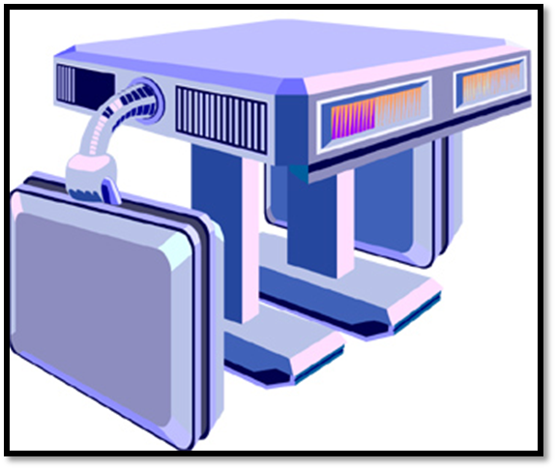
SECTION 2 - Classification of robots (4 of 10)
First Generation Industrial Robot
Designed and Built in the 1950s
Copyright © Texas Education Agency, 2012. All rights reserved.

Slide 67
SECTION 2 – Classification of robots (5 of 10)
6. Classification by Design
1.5 Generation of Industrial Robots – can adapt to varying situations by the use of sensors and a closed-loop servo controller. The robot may “know” when something is wrong in the system it may not be capable of doing anything about it. It then requests human help. These are today’s robots.
Copyright © Texas Education Agency, 2012. All rights reserved.

Slide 68
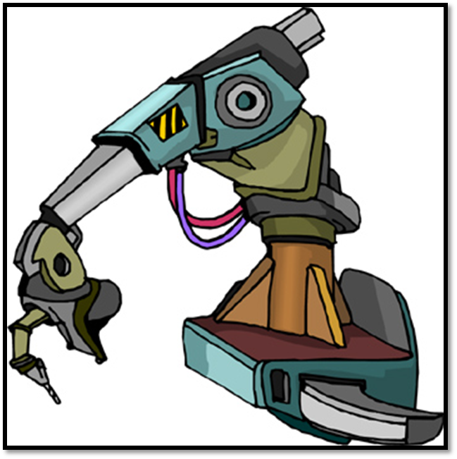
SECTION 2 - Classification of robots (6 of 10)
Examples of 1.5 Generation Industrial Robots
Copyright © Texas Education Agency, 2012. All rights reserved.

Slide 69
SECTION 2 – Classification of robots (7 of 10)
6. Classification by Design
Second Generation of Industrial Robots – are robots in the near future. Vision systems in conjunction with better mobility systems will make robots much more efficient and flexible. More intelligent microprocessors coupled with voice recognition and hand to hand coordination will expand the usefulness of robot systems. These robots will be able to make decisions and will be able to make minor corrections or adjustments to manipulators.
Copyright © Texas Education Agency, 2012. All rights reserved.

Slide 70
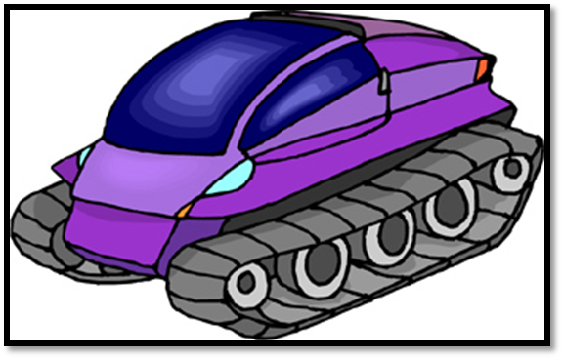
SECTION 2 - Classification of robots (8 of 10)
Mars Exploration Rover Technology
Second Generation Industrial Robot
Designed and Built in the 2004
Copyright © Texas Education Agency, 2012. All rights reserved.

Slide 71
SECTION 2 – Classification of robots (9 of 10)
6. Classification by Design
2.5 Generation of Industrial Robots. Perceptual motor functions will be the highlight of these robots. Response to sensory stimuli will provide control of motion. If initial sequence of steps are provided for the robot task the robot will be able to decide what to do next to accomplish the specific task.
Copyright © Texas Education Agency, 2012. All rights reserved.

Slide 72
SECTION 2 – Classification of robots (10 of 10)
6. Classification by Design
Third Generation of Industrial Robots – are the really smart robots. If the robots have generalized information about what tasks need to be done they will be able to decide the best way to accomplish the task.
Copyright © Texas Education Agency, 2012. All rights reserved.

Slide 73
SECTION 2 – Classification of robots (1 of 5)
7. Classification by LERT
The LERT Classification System uses four basic robot motions for a classification scheme:
Linear (L-Type)
Extensional (E-Type)
Rotational (R-Type)
Twisting (T-Type)
Copyright © Texas Education Agency, 2012. All rights reserved.

Slide 74
SECTION 2 – Classification of robots (2 of 5)
7. Classification by LERT
Linear Motion (L-Type) – occurs when one part moves along the outside of another part, such as in a rack-and-pinion system.
Copyright © Texas Education Agency, 2012. All rights reserved.

Slide 75
SECTION 2 – Classification of robots (3 of 5)
7. Classification by LERT
Extensional Motion (E-Type) – is telescoping motion, produced when one part moves within another part.
Copyright © Texas Education Agency, 2012. All rights reserved.

Slide 76
SECTION 2 – Classification of robots (4 of 5)
7. Classification by LERT
Rotational Motion (R-Type) – is caused by a part moving about something other than its center.
Copyright © Texas Education Agency, 2012. All rights reserved.

Slide 77
SECTION 2 – Classification of robots (5 of 5)
7. Classification by LERT
Twisting Motion (T-Type) – is produced by a part turning about its center.
Copyright © Texas Education Agency, 2012. All rights reserved.

Slide 78
SECTION 2 – Classification of robots
LERT Number
Arm Configuration | Reach | LERT Certification
Rectangular of Cartesian Coordinates | Only in front of itself | L³
Cylindrical Coordinates | Around itself | L²/R¹
Polar or Spherical Coordinates | Above, below, and around itself | L¹/R²
SCARA (Pointed Arm Horizontal) | Around itself or around an obstacles | R³
Revolute (Jointed Arm Vertical) | Above, below, and around itself, and read over or under and obstacle | R³
Copyright © Texas Education Agency, 2012. All rights reserved.

Slide 79
The Evolution of robotics Rubrics
Copyright © Texas Education Agency, 2012. All rights reserved.
Graded Elements | Total Points
One Page Essay | 50
Response to Questions | 20
Proofreading, Grammar and Spelling | 20
Reflection | 10
Total Points | 100

Slide 80
Assignment (1 of 2)
Instructions: You will respond to the questions below and will write an one page essay.
Technology makes the production of computers and robots easier, companies will continue to design computers and robots.
Do you think computers and robots will ever be as intelligent as those in the movies?
What type of intelligent computers and robots will be produced by companies? When and what features will these computers and robots have?
How much will these computers and robots cost?
Copyright © Texas Education Agency, 2012. All rights reserved.

Slide 81
Assignment (2 of 2)
Reflection: O*NET Online has detailed descriptions of the world of work for use by job seekers, workforce development and HR professionals, students, researchers, and more! Visit the O*NET Online website (http://www.onetonline.org/). Do you think that this website may help you locate career opportunities in Robotics? What types of Robotics career opportunities are listed?

Slide 82
References (1 of 2)
ROBOTICS Introduction, Programming, and Projects – Second Edition by James L. Fuller
O-NET Online - http://www.onetonline.org
ClipArt – http://www.clipart.com/en/
Merriam-Webster Online Dictionary - http://www.merriam-webster.com/
Copyright © Texas Education Agency, 2012. All rights reserved.

Slide 83
References (2 of 2)
FIRST Robotics
http://www.usfirst.org/aboutus/first-history
BEST (Boosting Engineering, Science, and Technology) http://www.bestinc.org/b_history.php
Copyright © Texas Education Agency, 2012. All rights reserved.

